Slide 1
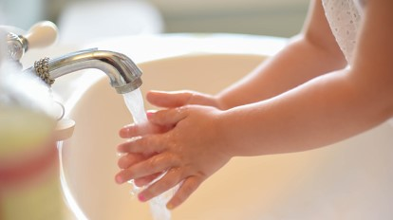
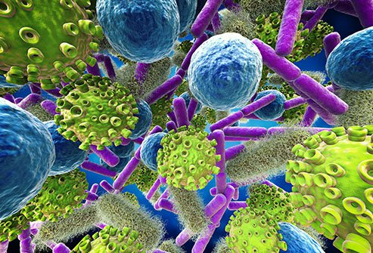
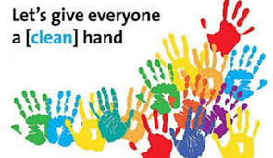
Hand Washing:Is It really Important…
Dr.Suryawanshi V.S.
Asso.Prof.of Chemistry,
Shri Chhatrapati Shivaji College,Omerga.

Slide 2
Outline of Presentation……..
1.Everything you need to know about infections…
2. Diseases due to attack of Germs..
3.Aim of hand washing
4.When and how we wash…
5.Role of sanitizers
6.Global hand washing day
7.About Ignaz Semmelweis
8.Handwash techniques..
9.The impact of health care associated infections (HCAI)
10.Conclusion.

Slide 3
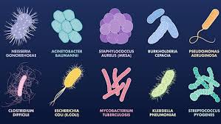
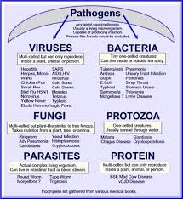
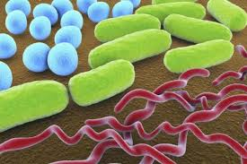
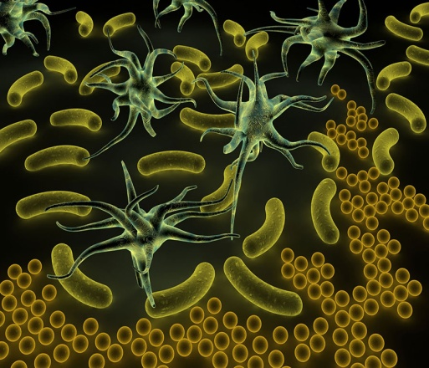
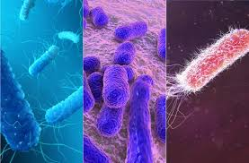
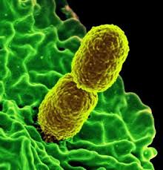
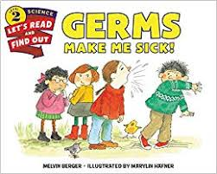
1.Germs around us and their Infections….
Infectious diseases are disorders that are caused by organisms.
usually microscopic in size ( 0.1 nm to 1mm) seen by electron microscope or light microscope.
Examples are bacteria, viruses, fungi, or parasites.
They are passed, directly or indirectly, from one person to another.

Slide 4
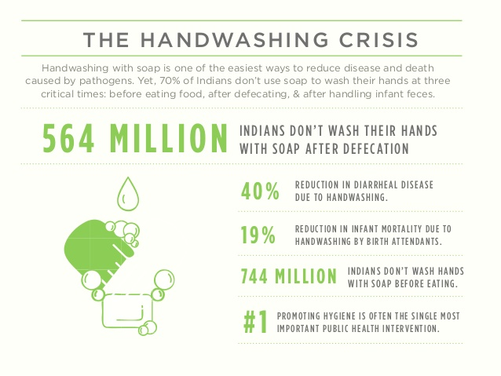
Everything you need to know about infections
1.Tuberculosis ( 22.79 millions diagnosed at 2016 in India)..Drug resistance TB
Bacterial diseases : 2.Chlorea 3.diphetria 4.Dysentery 5.Pneumonia 6.Tubercuulois 7.Typhoid 8.Typhus bacterial Infections 9.Meningititis 10.Otitis media (Ear infection) 11.upper respiratory tract infection 12.Gastritis food poisoning 13. Eye infections 14.Sinutitis 15.Urinary tract infections 16.Skin infections 17 sexually transmitted diseases.
Fungal Infections 18. valley fever 19.Athletes foot 20. Ringworm 21.Eye infections 22.Prion diseases (Brain damage/ other part of Nervous system damaged
Other infections: 23.Helminths 24.Ectoparasits ( caused by mites,tick,lice)

Slide 5
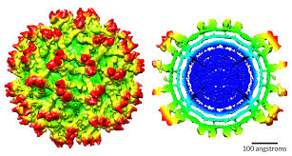
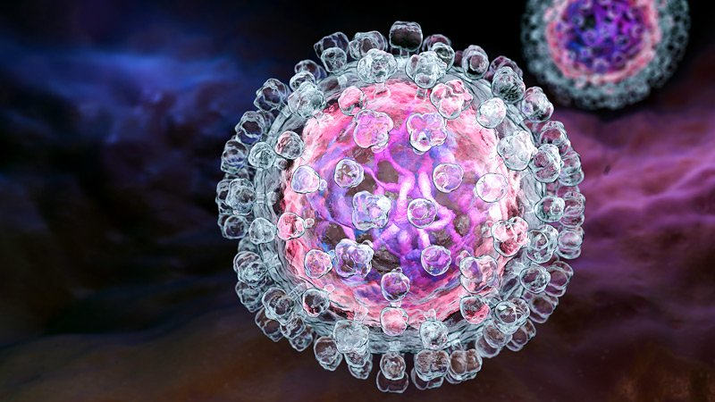
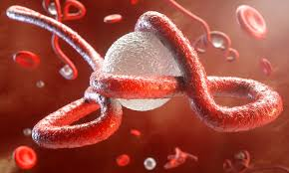
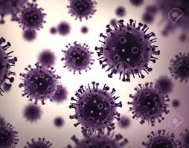
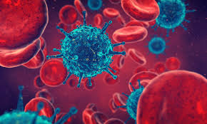
Viruses of Special Concern
Zika Virus ( Mosquito born)
HIV
Hepatitis
Polio
Influenza
Dengue fever
H1 N1 Swine flu
Ebola
Middle east respiratory Syndrome (MERS)
Zika virus
Hepatitis virus
Ebola Virus
H1 N1 Virus
HIV Virus

Slide 6
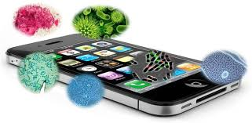
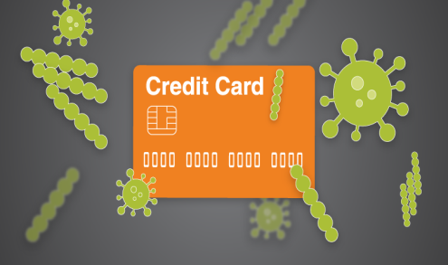
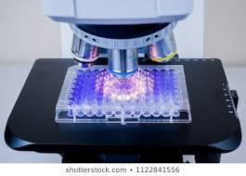
3.Aim of hand washing
Bacteria, fungus ,virus ,Parasites are everywhere…
eg .Credit card, Biometric machine and mobile phone also…..
Also known as hand hygiene, is the act of cleaning.
Removing soil, dirt, and microorganisms. ...
Hand washing before administering medicine or medical care can prevent or minimize the spread of disease.
help prevent and control the spread of many illnesses
Good hand hygiene will reduce the risk of things like flu, food poisoning and healthcare associated infections being passed from person to person.
Keeping your workplace and hands free from bacteria
Obstruction of respiratory tract infections
Creating a safer working environment
Prevention of diarrhea and other intestinal diseases
……Proper handwashing keeps you healthy

Slide 7
4.When and how we wash…
1.Before contact with a patient or patient environment….
After body fluid exposure
Contact with contaminated items

Slide 8
After contact with a patient
1.Before eating or handling food;
2. After using the toilet;
3.After blowing your nose, coughing or sneezing;
4.After touching animals or animal waste;
5.After handling rubbish;
6.After changing a nappy;
7.Before and after touching a sick or injured person; cut or wound
8.Before and after visiting a hospital ward (remember alcohol-based hand rubs are also provided). 9.Before, during, and after preparing food Before eating food
10.After changing diapers or cleaning up a child who has used the toilet
11.After handling pet food or pet treats
12.After touching garbage.

Slide 9
HOW….?????
…….Life is Better with Clean Hands…..
Steps;
1.Wet your hands with clean, running water (warm or cold), turn off the tap, and apply soap.
2.Lather your hands by rubbing them together with the soap. Lather the backs of your hands, between your fingers, and under your nails.
3.Scrub your hands for at least 20 seconds. Need a timer? Hum the “Happy Birthday” song from beginning to end twice.
4.Rinse your hands well under clean, running water.
Dry your hands using a clean towel or air dry them. Use Hand Sanitizer When You Can’t Use Soap and Water……(quickly reduces the number of germs)
1.Apply the gel product to the palm of one hand (read the label to learn the correct amount).
2.Rub your hands together.
3. Rub the gel over all the surfaces of your hands and fingers until your hands are dry. This should take around 20 seconds. Caution! Swallowing alcohol-based hand sanitizers can cause alcohol poisoning if more than a couple of mouthfuls are swallowed. Keep it out of reach of young children and supervise their use.

Slide 10
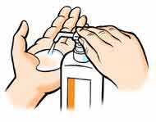
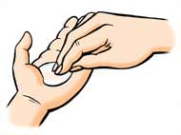
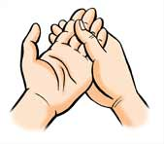
Use this technique to clean your hands when using alcohol gel
1
2
3
Squirt once or twice into the palm of your left hand
Dip your right hand fingers into the gel making contact with your left palm
Transfer the remaining gel into your right palm
4
5
6
Dip your left hand fingers into the gel making contact with the right palm
Then rub the remaining gel all over your hands, make sure you rub the backs of your hands too.

Slide 11
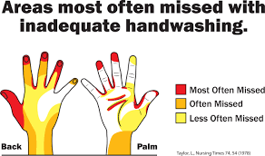
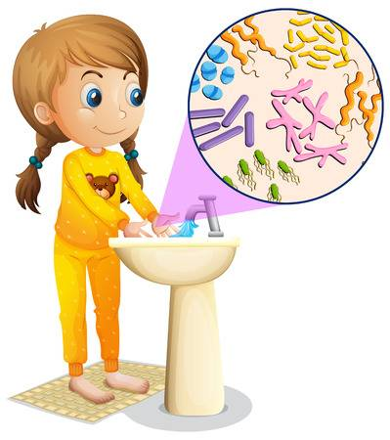
Time constraint = major obstacle for hand hygiene
1. Adequate hand washing with water and soap requires 40–60 seconds
2. Average time usually adopted by health-care workers: <10 seconds 3.Alcohol-based Hand rubbing: 20–30 seconds
5.Role of sanitizers
Hand sanitizer is a liquid
generally used to decrease infectious agents on the hands.
Formulations of the alcohol-based type are preferable to hand washing with soap and water in most situations
It is generally more effective at killing microorganisms and better tolerated than soap and water.

Slide 12
6.Global hand washing day …… ( 15 October) 2019 Global Hand washing Day theme is “Clean Hands for All…
Global Hand washing Day is an annual global advocacy day dedicated to advocating for hand washing with soap
It is an easy, effective, and affordable way to prevent diseases and save lives.
Each year, over 200 million people celebrate Global Hand washing Day
Aims:
The stated aims of Global Hand washing Day are to Foster and support a general culture of hand washing with soap in all societies
Shine a spotlight on the state of hand washing in each country
Raise awareness about the benefits of hand washing with soap.

Slide 13
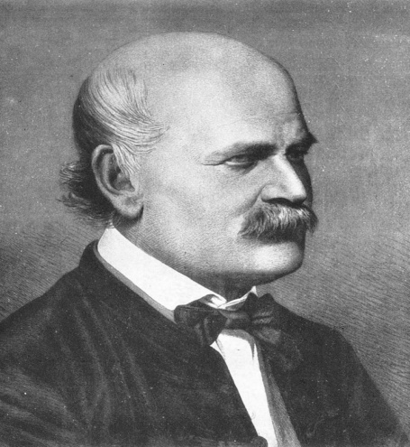
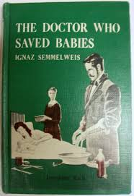
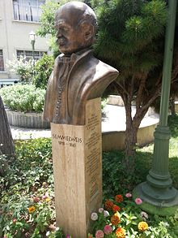
7.About Ignaz
The Doctor Who Championed Hand-Washing And Briefly Saved Lives.
Physician and scientist, now known as an early pioneer of antiseptic procedures.
incidence of puerperal fever (also known as "childbed fever") A story….
practice of washing hands with chlorinated lime solutions in 1847 while working in Vienna General Hospitals First Obstetrical Clinics.
Semmelweis Ignác Fülöp July 1, 1818 Buda, Kingdom of Hungary (now part of Budapest, Hungary)
Died | August 13, 1865 (aged 47) of Vienna, Austria)
Residence | Hungary
Citizenship | Kingdom of Hungary
Known for | Introducing hand disinfection standards, in obstetrical clinics, from 1847
Scientific career
Fields | Obstetrics, surgeries
Semmelweis statue at the University of Tehran

Slide 14
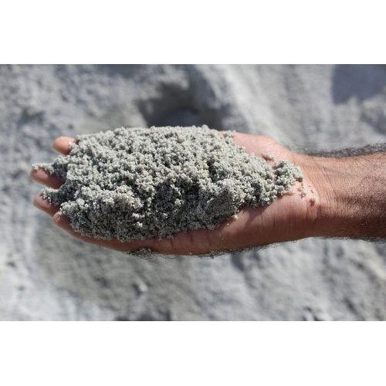
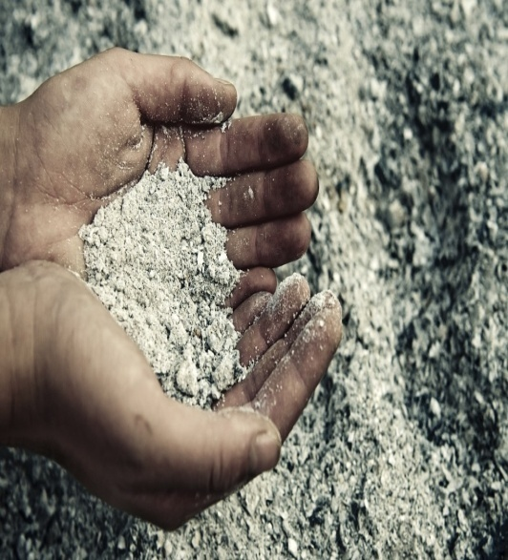
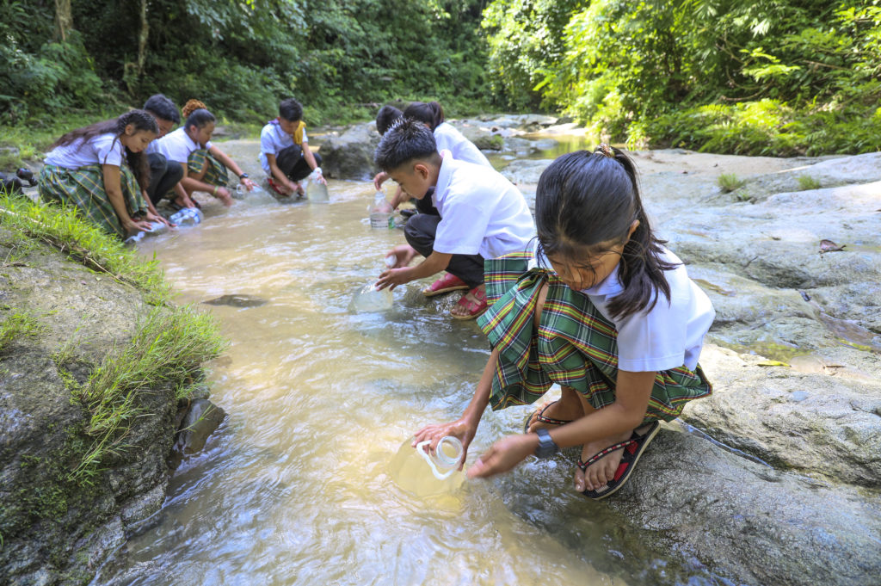
Ash as a neglected low-cost alternative for soap for hand washing (and disinfectant)????????
low-income communities cannot afford soap and use ash or soil instead.
Ash or soil may be more effective than water alone, but may be less effective than soap.
Evidence quality is poor. One concern is that if the soil or ash is contaminated with microorganisms it may increase the spread of disease rather than decrease it.
Like soap, ash is also a disinfecting agent (alkaline).
WHO recommended ash or sand as alternative to soap

Slide 15
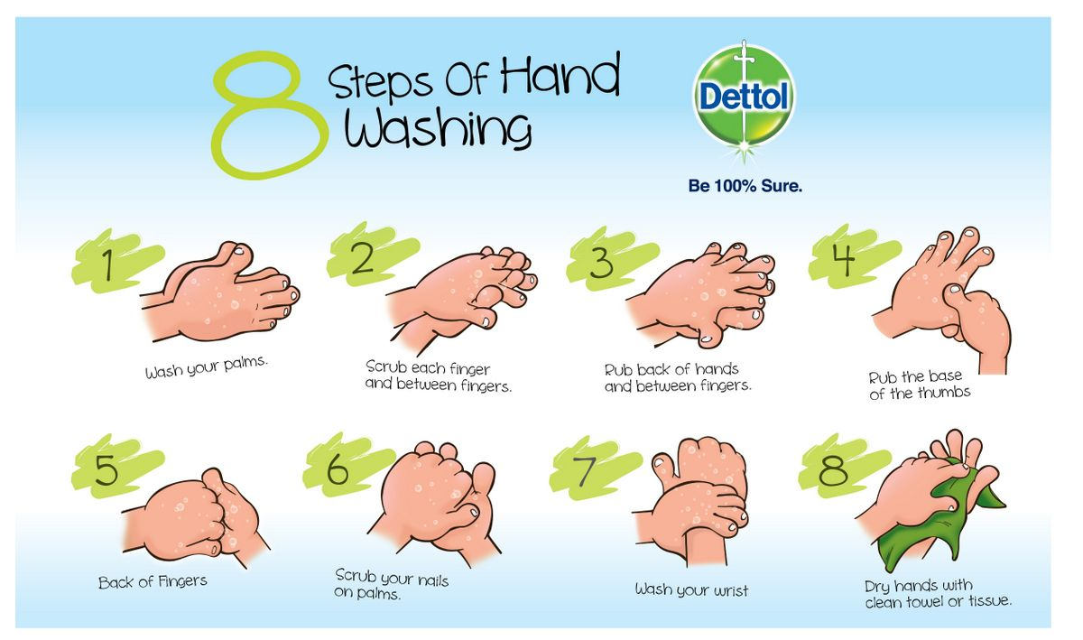
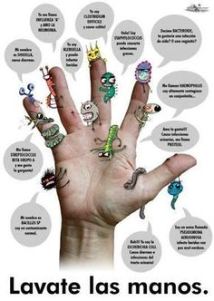
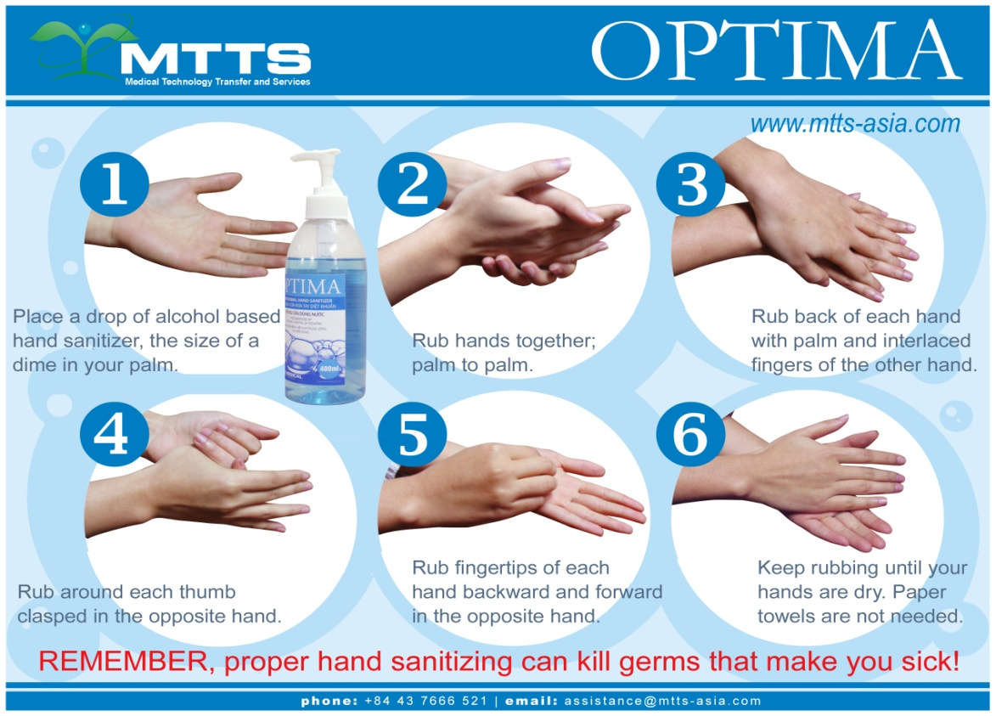
8.Handwash techniques

Slide 16
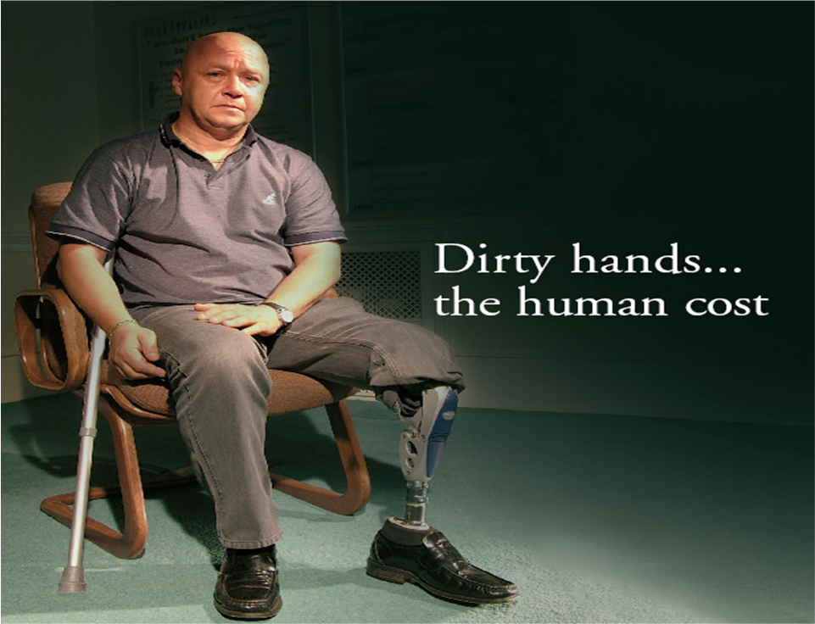
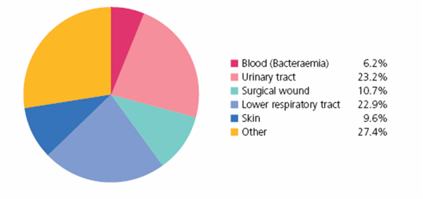
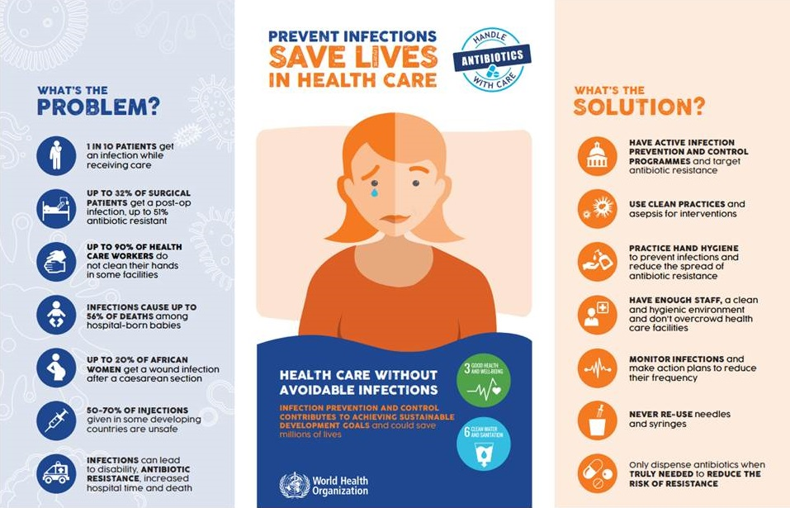
9.The impact of health care associated infections (HCAI)
HCAI can cause:
more serious illness
prolongation of stay in a health-care facility
long-term disability
excess deaths
high additional financial burden
high personal costs on patients and their families.
A total of 49540 HAIs occurred in the 68 surveyed hospitals in 2015, and the number of HAIs at five surveyed sites was 38858.

Slide 17
10.Conclusion.

Slide 18
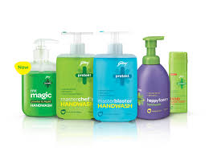
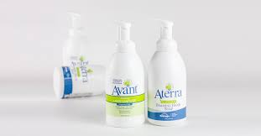
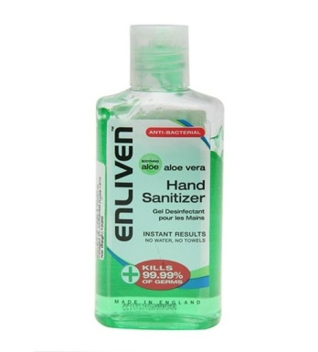
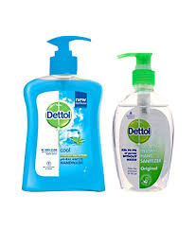
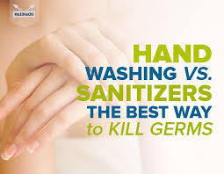
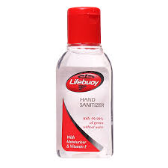
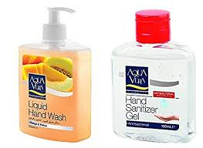
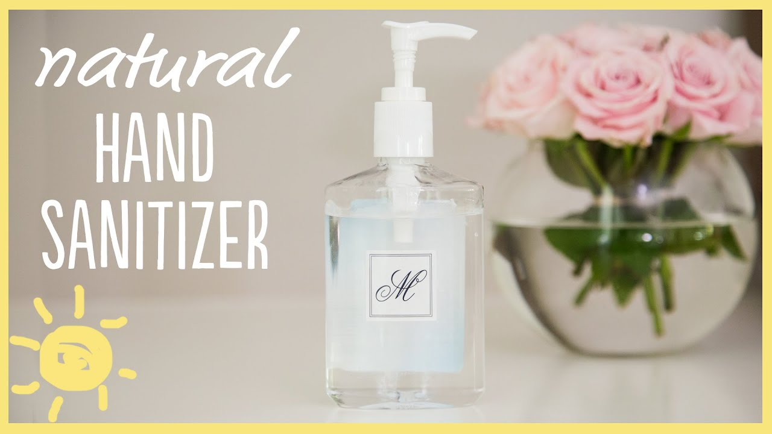
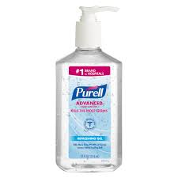
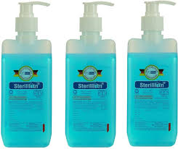
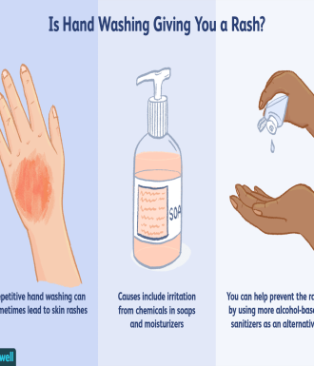
….we are in the world of Hygiene….

Slide 19
..A Message for you….

Slide 20
